Slide 1
Carrier Tracker Beta 1.0
Track the tracking numbers

Slide 2
All slides
Scope
Flow diagram
Features
Issues
Demo
QA

Slide 3
CarrierTracker
Scope
Database
Update Info table
Insert History
Insert Log
Logs
Email

Slide 4
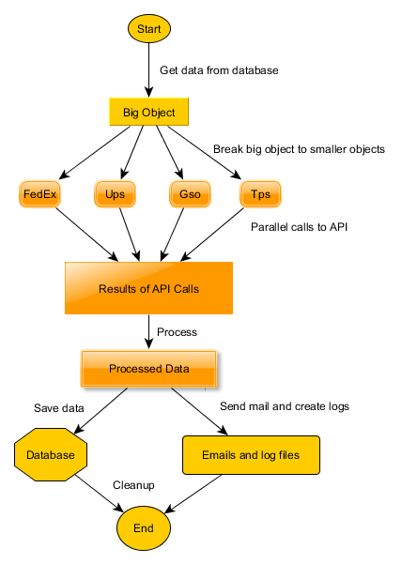
Flow

Slide 5
Features
Single thread asynchronous
Auto adjust piston
Multiple Connections to database
Configurable
Database logging
File logging
Status mail
10,000 records in 6 minutes

Slide 6
Issues
Accuracy
FedEx status > 50 chars issue
USPS site not working
> 50K records memory heavy
Better logging required

Slide 7
Demo
Show local run with 10k records
Piston
Logging
2 second snapshot
Memory foot print
Show Azure run

Slide 8
QA

